Slide 1

Home Rental Management System

Slide 2

MD.Zahir Rayhan18201048 Sumaiya Akter18201056
MD.Zahir Rayhan ||18201048 Sumaiya Akter ||18201056

Slide 3

Objective
Objective
The objective of this project entitled “House Rental System” is to provided e user friendly and easily untestable to manage the details of House, Rent, Customer, Payment, House status. It manages all the information about House ,Rent and Booking and house status. This project also helps user to search home on rent in particular city.
The objective of this project entitled “House Rental System” is to provided e user friendly and easily untestable to manage the details of House, Rent, Customer, Payment, House status. It manages all the information about House ,Rent and Booking and house status. This project also helps user to search home on rent in particular city.

Slide 4
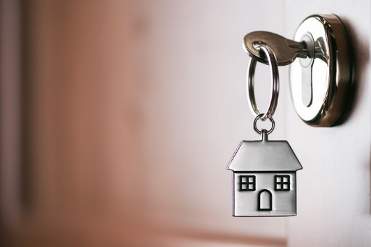
Goal
Goal
Providing the home searching facilities based on various factors.
Shows the information and description of house , owner and customer.
Tracks all the information of rent, booking and payment etc.
Manage the information of house.
Manage the information of owner.
Manage the information of customer.
Providing the home searching facilities based on various factors.
Shows the information and description of house ,owner and customer.
Tracks all the information of rent, booking and payment etc.
Manage the information of house.
Manage the information of owner.
Manage the information of customer.

Slide 5
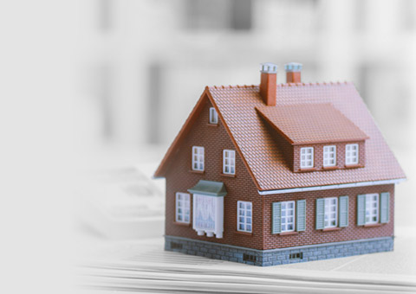
Features :
Features :
Advertisement
House
Landlord
Renter
User
Advertisement
House
Landlord
Renter
User

Slide 6

Software Requirements:
Software Requirements:
Technology : Python Django
IDE : Pycharm professional
Frontend technology : HTML, CSS, JavaScript, Bootstrap
Backend Technology : Python, Database
Operating System : Microsoft windows
Technology : Python Django
IDE : Pycharm professional
Frontend technology : HTML, CSS, JavaScript, Bootstrap
Backend Technology : Python, Database
Operating System : Microsoft windows

